Slide 2

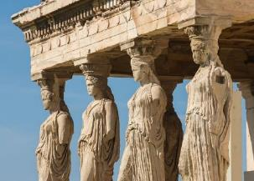
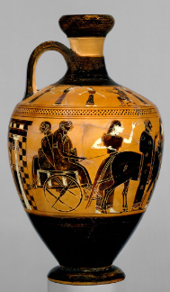
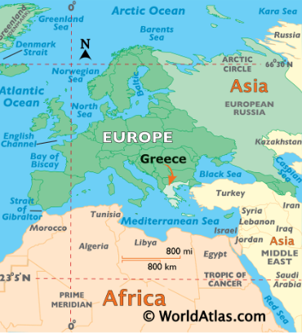
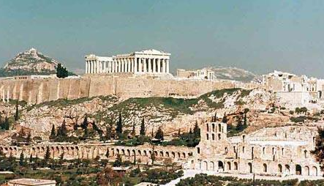
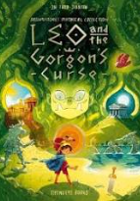
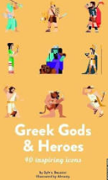
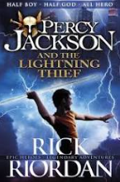
Ancient Greeks Year 5 Knowledge Mat
Subject Specific Vocabulary |  | v | Where is Greece?
philosophy | Philosophy is a way of thinking about the world, the universe, and society. Three famous Ancient Greek philosophers are: Socrates, Plato, Aristotle
Athenians | It is the birth place of democracy and the heart of the Ancient Greek civilization.
Spartans | The Spartans believed that strict discipline and a tough upbringing was the secret to making the best soldiers.
democracy | Democracy means allowing citizens to make their own decisions for their own personal lives
Olympics | The ancient Olympic Games were originally a festival, or celebration of and for Zeus | Sticky Knowledge about Ancient Greece
plague | The Plague of Athens was an epidemic that devastated the city-state of Athens. | The Ancient Greeks invented the theatre because they loved watching plays, and most cities had a theatre.
truce | Is when two fighting sides declare peace or a break in the war. |  | Exciting Books
 |  | Events at the Greek’s Olympics included wrestling, boxing, long jump, javelin, discus and chariot racing.
Zeus | The supreme god of the Olympians, Zeus was the father of Perseus and Heracles.
Greek Empire | A state ruled by one single person. The Greek empire was known as a hub of trade, philosophy, athletes, politics and architecture | The Ancient Greeks held many festivals in honour of their gods.
 |  | Most Ancient Greeks wore a chiton, which was a long T-shirt made from one large piece of cotton. The poor slaves, however, had to make do with a loincloth.
Apollo | Apollo is the god of music, truth and prophecy.
Battle of Marathon | A special truce called whilst the Olympics were taking place.
temple | A building devoted to the worship of a god or gods.

