Slide 1

Year 5: Autumn 1 Knowledge Organiser - Forces
Subject Specific Vocabulary |  | Interesting Book | Sticky Knowledge about Forces
friction | Friction is a force between two surfaces that are sliding, or trying to slide, across each other.
 |  |  | Frictional force is any force that is caused due to friction. An example of this might be when you put on the brakes on your bike.
gravity | Gravity is a force which tries to pull two objects toward each other.
air resistance | Air resistance is a type of friction between air and another material. For example, when an aeroplane flies through the air.
intestine |  |  | Gravity is the pulling force acting between the Earth and a falling object, for example when you drop something. Gravity pulls objects to the ground.
water resistance | If you go swimming, there is friction between your skin and the water particles.
 |  |  | Surface resistance is the force on objects moving across a surface, such as an ice-skater skating on ice.
levers | A lever can be described as a long rigid body with a fulcrum along its length.
pulleys | Pulley is a simple machine and comprises of a wheel on a fixed axle, with a groove along the edges to guide a rope or cable.
 |  | Important facts to know by the end of the forces topic: | Any kind of force is really just a push or a pull.
gears | Gears are wheels with teeth that slot together. When one gear is turned the other one turns as well. | know what gravity is and its impact on our lives. identify and know the effect of air resistance. identify and know the effect of water resistance. identify and know the effect of friction. explain how levers, pulleys and gears allow a smaller force to have a greater effect. know who Isaac Newton and Galileo were. | Air resistance is the force on an object moving through air, such as a plane moving through the sky. Air resistance affects how fast or slowly objects move through the air
parachute | A parachute is a device used to slow down an object that is falling towards the ground. As the parachute opens, the Air resistance increases.
 |  |  | Water resistance is the force on objects floating on or moving in water.
Galileo | Galileo developed the telescope to enable close observation of the night sky.
 |  |  | Magnetic force is an invisible force created by electrons. Magnetic force controls magnetism and electricity.
Newton | During his lifetime Newton developed the theory of gravity and made breakthroughs in the area of optics such as the reflecting telescope.

Slide 2

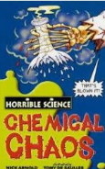
Year 5: Autumn 2 Knowledge Organisers - Reversible and Irreversible Changes
Subject Specific Vocabulary |  | Interesting Books | Sticky Knowledge about Reversible and Irreversible changes
solubility | Is a chemical property referring to the ability for a given substance, the solute, to dissolve in a solvent.
 |  |  | Irreversible changes, like burning, cannot be undone. Reversible changes, like melting and dissolving, can be changed back again.
conductivity | Conductivity defines a material's ability to conduct electricity.
transparency | In general, transparency is the quality of being easily seen through.
thermal evaporation | Something that is thermal is hot, retains heat, or has a warming effect. Evaporation is the process of a substance in a liquid state changing to a gaseous state due to an increase in temperature and/or pressure. |  | Mixtures can be separated out by methods like filtering and evaporating. A change is called irreversible if it cannot be changed back again.
 |  | Important facts to know by the end of the reversible and irreversible changes topic:
dissolve | To dissolve is defined as to become broken up or absorbed by something or to disappear into something else. |  | Examples of reversible changes. Melting: Melting is when solid converts into a liquid after heating. Example of melting is turning of ice into water. Freezing: Freezing is when a liquid converts into a solid.
 |  | Know what a reversible change means. Know what an irreversible change means. Give examples of reversible and irreversible changes. Know that some materials will dissolve in liquid to form a solution, and describe how to recover a substance from a solution. Use knowledge of solids, liquids and gases to decide how mixtures might be separated, including through filtering, sieving and evaporating
bicarbonate of soda | a white water-soluble powder, used chiefly as an antacid, a fire extinguisher, and a leavening agent in baking.
thermal | Something that is thermal is hot, retains heat, or has a warming effect
 |  |  | A cooked egg cannot be changed back to a raw egg again. Mixing substances can cause an irreversible change. For example, when vinegar and bicarbonate of soda are mixed, the mixture changes and lots of bubbles of carbon dioxide are made. Burning is an example of an irreversible change.
filtering | To filter a substance means to pass it through a device which is designed to remove certain particles contained in it.
melting | Melting, is a physical process that results in the phase transition of a substance from a solid to a liquid.
separate | separate, part, and divide mean to break into parts or to keep apart.

Slide 3
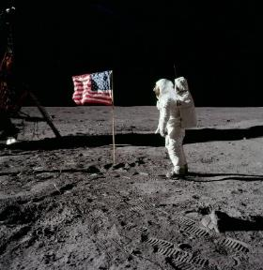
Year 5: Spring 1 Knowledge Organiser - Earth and Space
Subject Specific Vocabulary |  |  | Sticky Knowledge about Earth and space
orbit | An orbit is a repeating path that one celestial body takes around another.
 |  |  | One million Earths could fit inside the sun – and the sun is considered an average-size star.
solar system | The solar system is made of the eight planets that orbit our sun it is also made of asteroids, moons, comets and lots, lots more.
 |  |  | An asteroid about the size of a car enters Earth’s atmosphere roughly once a year – but it burns up before it reaches us.
astronomical | Astronomy is the study of outer space focusing on celestial bodies such as stars, comets, planets, and galaxies.
planet | There are 8 planets in our solar system, they are Mercury, Venus, Earth, Mars, Jupiter, Saturn, Uranus and Neptune.
 |  |  | The sunset on Mars appears blue.
rotation | Rotation is when the shape is turned around a point. |  | Earth, is the third planet from the sun and the only world known to support an atmosphere with free oxygen, oceans of liquid water on the surface and life.
spherical | Something spherical is like a sphere in being round, or more or less round, in three dimensions. | Important facts to know by the end of the Earth and space topic:
crescent moon | It is a slither of the moon that is lit up and can be seen. It is less than half the moon. | know about and explain the movement of the Earth and other planets relative to the Sun. know about and explain the movement of the Moon relative to the Earth. know and demonstrate how night and day are created. describe the Sun, Earth and Moon (using the term spherical). Know information about the planets. Neil Armstrong was the first man to step on the moon. | There is no atmosphere in space, which means that sound has no medium or way to travel to be heard.
gibbous moon | The best way to describe a gibbous moon is that the moon is three-quart lit up.
 |  |  | Venus is the hottest planet in the solar system and has an average surface temperature of around 450° C
eclipse | An eclipse occurs when an astronomical object is temporarily obscured. A lunar eclipse is when the Earth moves between the sun and the moon, therefore blocking the sun's rays from striking the moon
lunar | Is anything related to the moon. |  | The sheer size of space makes it impossible to accurately predict just how many stars we have.
lunar | Is anything related to the moon.

Slide 4
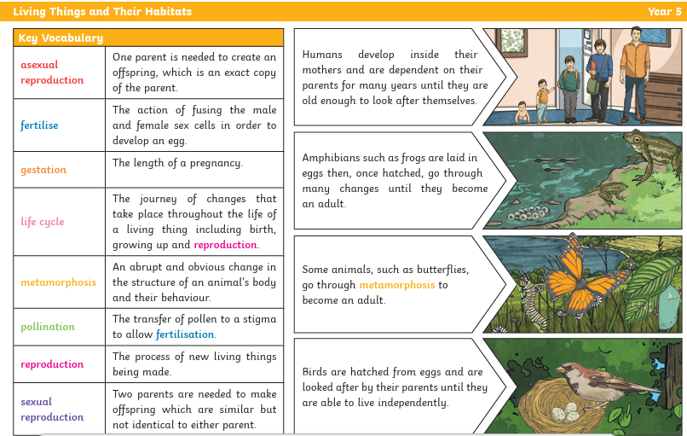
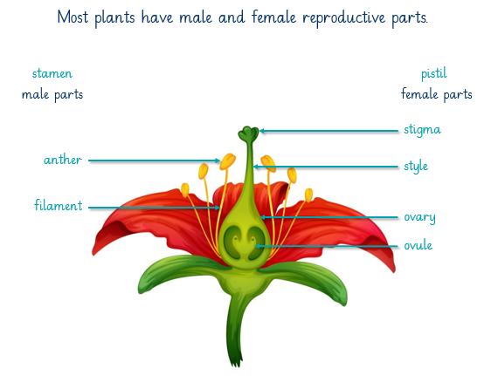
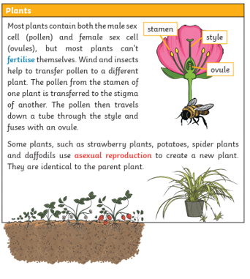
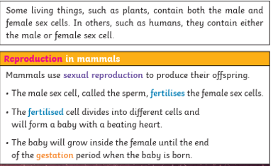
Year 5: Spring 2 Knowledge Organiser – Living things and their Habitat

Slide 5
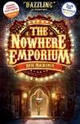


Year 5: Summer Knowledge Organiser - Life Cycles
Subject Specific Vocabulary |  | Interesting Books | Sticky Knowledge about Life Cycles
puberty | Is the name for the time when your body begins to develop and change as you move from childhood to adult.
 |  |  | The years between 6 and 14 -middle childhood and early adolescence - are a time of important developmental advances that establish children's sense of identity.
gestation | Gestation, in mammals, the time between conception and birth, during which the embryo is developing in the uterus.
classification | This is the grouping together of similar species of plant, animal and other organisms. |  | Many insects have four stages in their life cycle: egg or the unborn stage; larva – young stage; pupa – inactive no feeding) stage; and, adult stage.
precision | For scientists, precision describes a measurement system, that is, how good it is at giving the same result every time it measures the same thing.
 |  |  | In general, the life cycles of plants and animals have three basic stages including a fertilized egg or seed, immature juvenile, and adult. However, some organisms may have more than 3 life cycle stages, and the exact names of each stage can slightly differ depending on the species.
reproduction | It is the way different plants and animals make new plants and animals. The reproduction system differs in plants and animals.
 |  | Important facts to know by the end of the life cycles topic:
teenager | It is the age between thirteen and nineteen. The ‘teen’ element gives rise to the word teenager. It is a time that humans mature quite rapidly. | know the life cycle of different living things, e.g. mammal, amphibian, insect bird. know the differences between different life cycles. know the process of reproduction in plants. know the process of reproduction in animals. create a timeline to indicate stages of growth in humans.
obese | Obesity is the condition of being much too heavy for one's height so that one's health is affected. In other words, it means to be too overweight.
 |  |  | The early years, especially the first three years of life, are very important for building the baby's brain. A child's brain develops rapidly during the first five years of life, especially the first three years. It is a time of rapid cognitive, linguistic, social, emotional and motor development.
toddler | Is the period that a young child starts to walk and become more independent. |  | The early years, especially the first three years of life, are very important for building the baby's brain. A child's brain develops rapidly during the first five years of life, especially the first three years. It is a time of rapid cognitive, linguistic, social, emotional and motor development.
embryo | Fertilisation happens when an egg cell meets with a sperm cell and joins with it. The fertilised egg divides to form a ball of cells called an embryo

